Slide 1
Machine Learning - Algorithms
Raghu Prasad K S
Infidata Technologies

Slide 2
Introduction
Raghu Prasad – BE, MS
Total of 24 years of experience
7 years as a lecturer in Engineering College
17 Years into IT
Worked with companies like CISCO,CSC,ICICI,First Apex – NTT Data
Currently into Corporate training and consultancy
Worked with corporates and public sector
Technologies – Java,Python,Data Sciences,Web technologies,Java Script technologies (MEAN stack),IOT,Test Automation – Selenium,JMeter

Slide 3
Course Outline
Types of Machine Learning
Machine Learning Algorithms
Machine learning examples

Slide 4
Types of Machine Learning Algorithms
Broadly, there are 3 types of Machine Learning Algorithms
1. Supervised Learning
How it works: This algorithm consist of a target / outcome variable (or dependent variable) which is to be predicted from a given set of predictors (independent variables). Using these set of variables, we generate a function that map inputs to desired outputs. The training process continues until the model achieves a desired level of accuracy on the training data.
Examples of Supervised Learning: Regression, Decision Tree, Random Forest, KNN, Logistic Regression etc.

Slide 5
Types of Machine Learning Algorithms
2. Unsupervised Learning
How it works: In this algorithm, we do not have any target or outcome variable to predict / estimate. It is used for clustering population in different groups, which is widely used for segmenting customers in different groups for specific intervention.
Examples of Unsupervised Learning: Apriori algorithm, K-means.

Slide 6
Types of Machine Learning Algorithms
3. Reinforcement Learning:
How it works: Using this algorithm, the machine is trained to make specific decisions. It works this way: the machine is exposed to an environment where it trains itself continually using trial and error. This machine learns from past experience and tries to capture the best possible knowledge to make accurate business decisions. Example of Reinforcement Learning: Markov Decision Process

Slide 7
Common ML Algorithms
Linear Regression
Logistic Regression
Decision Tree
SVM
Naive Bayes
kNN
K-Means
Random Forest
Dimensionality Reduction Algorithms
Gradient Boosting algorithms
GBM ,XGBoost,LightGBM,CatBoost
REFERENCE - https://www.analyticsvidhya.com/blog/2017/09/common-machine-learning-algorithms/

Slide 8
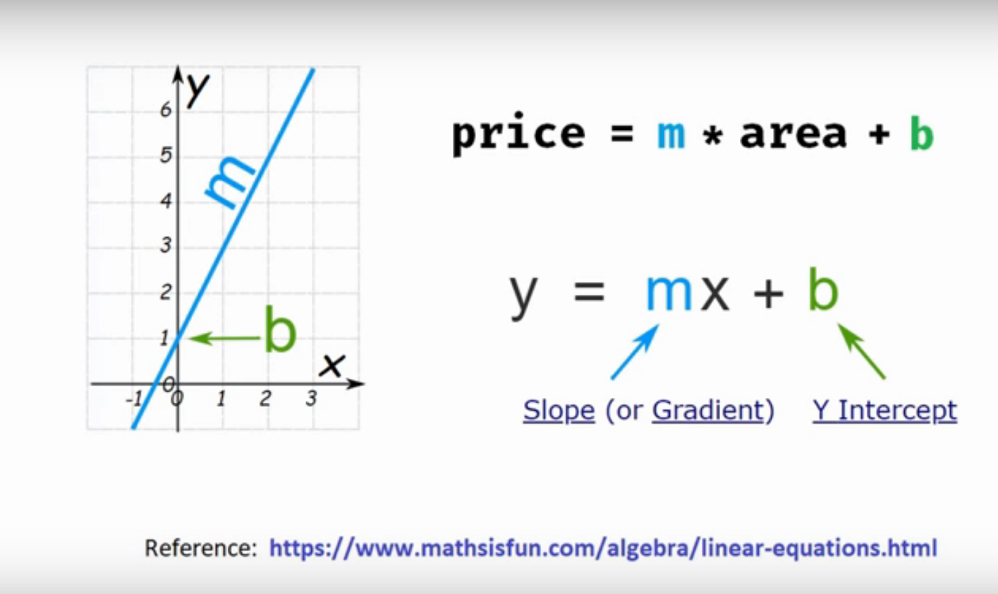
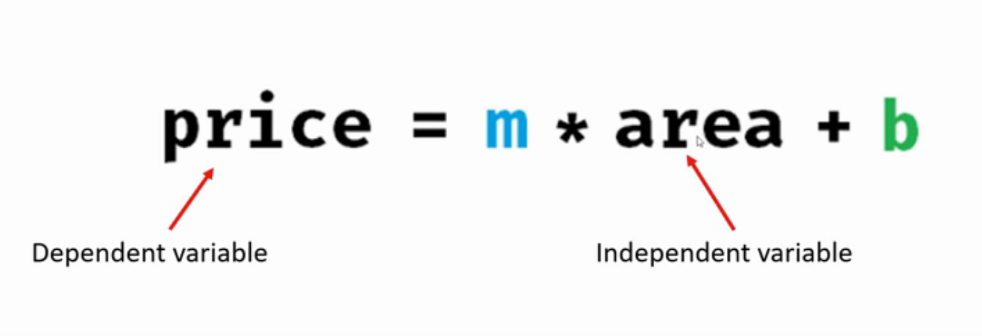
Linear Regression – Single Variable
Prediction of home price

Slide 9
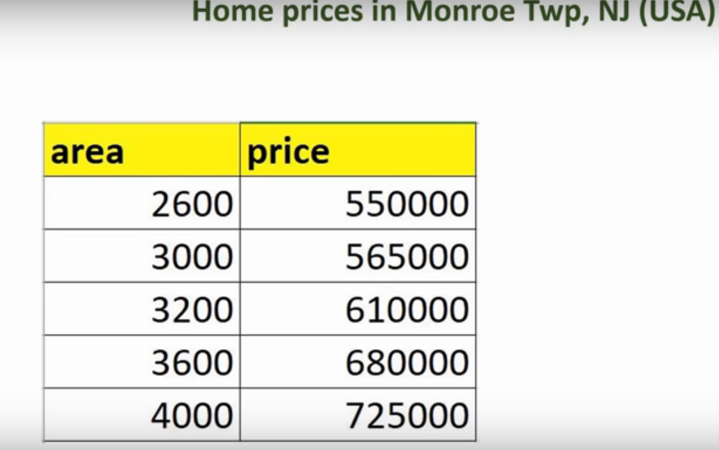
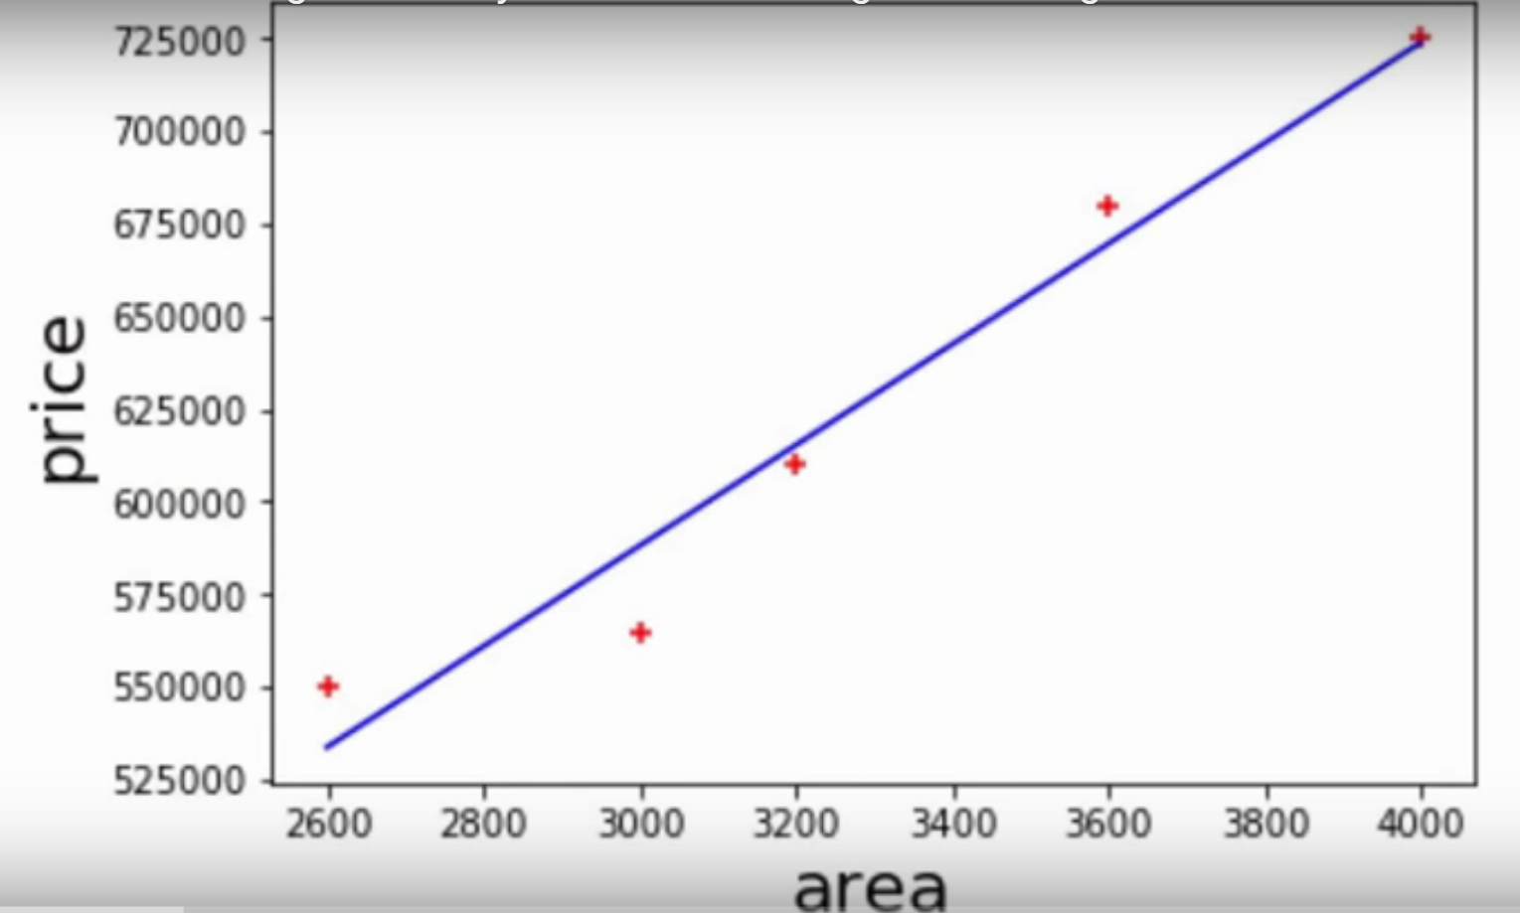
Linear Regression – Single Variable
Prediction of home price

Slide 10
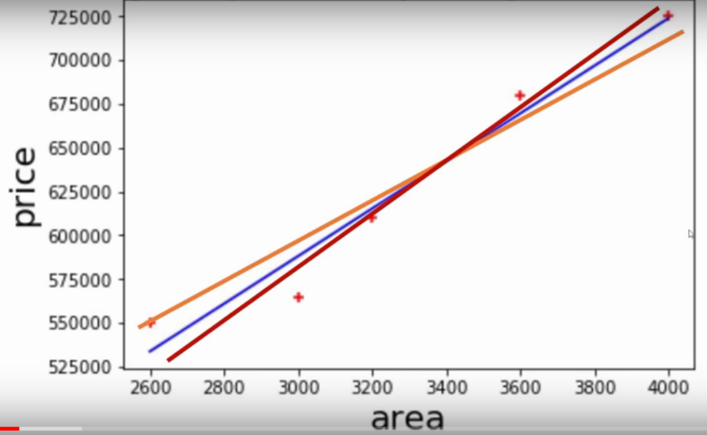
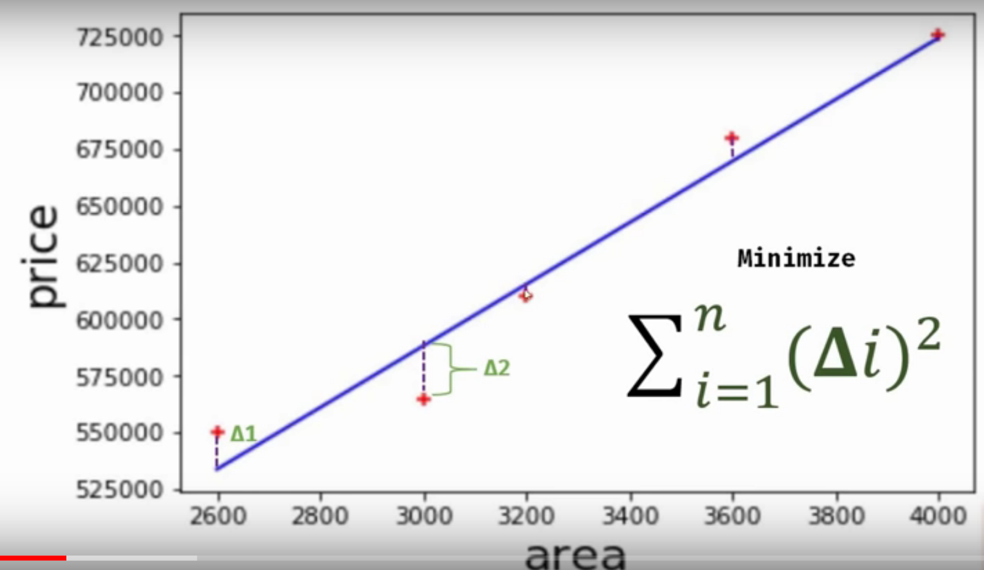
Linear Regression – Single Variable
Bestfit line

Slide 11
Linear Regression – Single Variable
Bestfit line

Slide 12
Linear Regression – Single Variable
Bestfit line

Slide 13
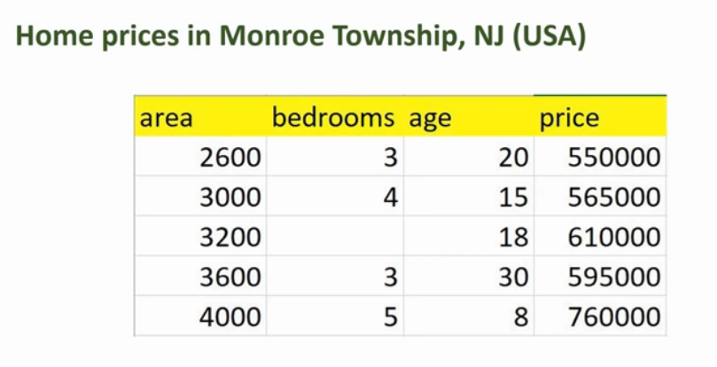
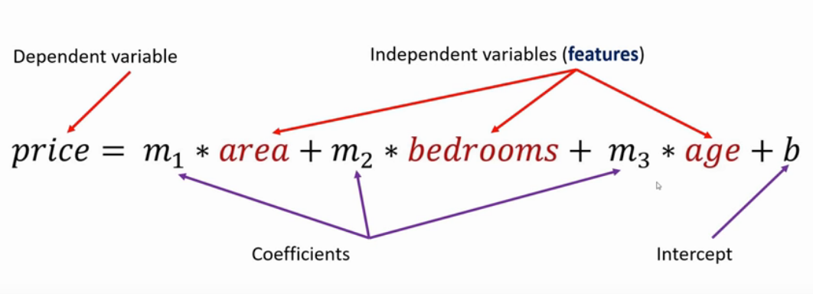
Linear Regression – Multiple Variable
Home price

Slide 14
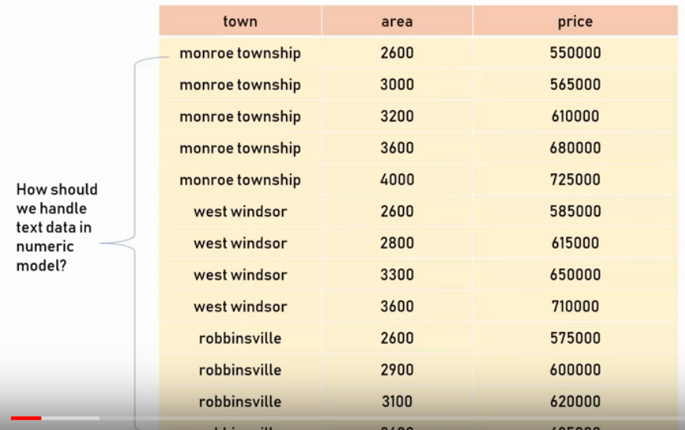
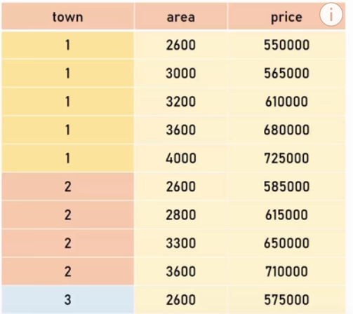
Dummy Variables – One Hot Encoding
Using Pandas – get_dummies
Using sklearn – OneHotEncoding

Slide 15
Dummy Variables – One Hot Encoding
Using Pandas – get_dummies
Using sklearn – OneHotEncoding

Slide 16
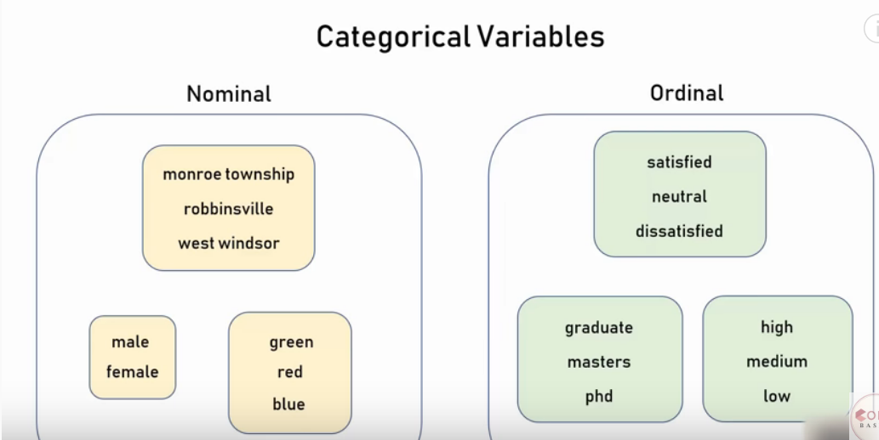
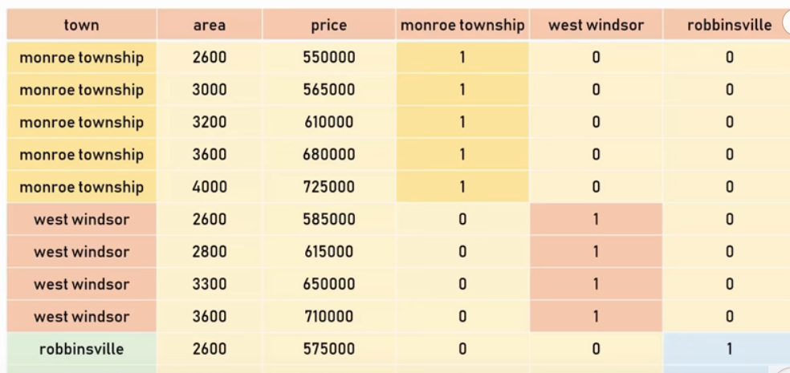
Dummy Variables – One Hot Encoding
Using Pandas – get_dummies
Using sklearn – OneHotEncoding

Slide 17
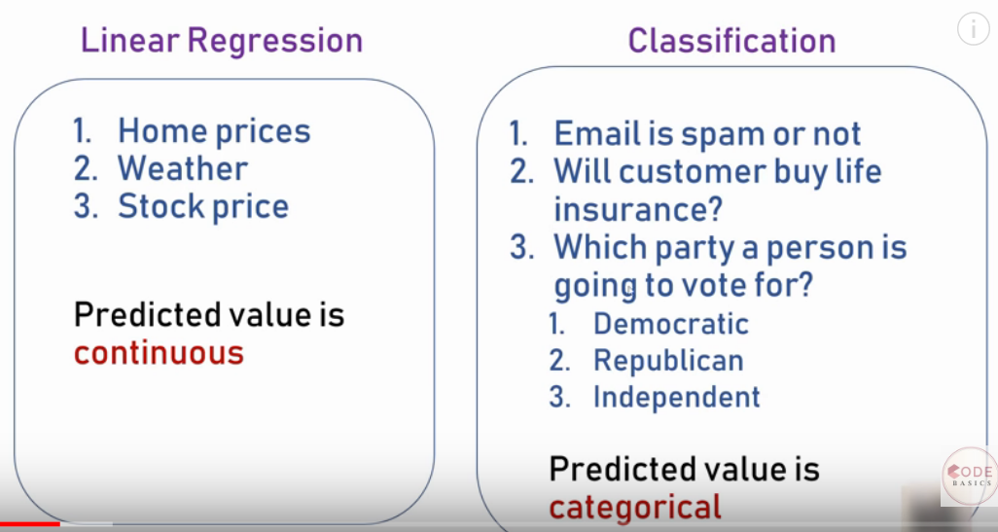
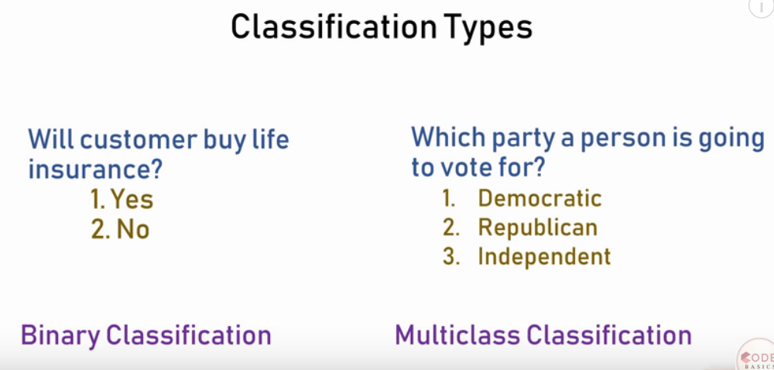
Logistic Regression – Binary Classification

Slide 18
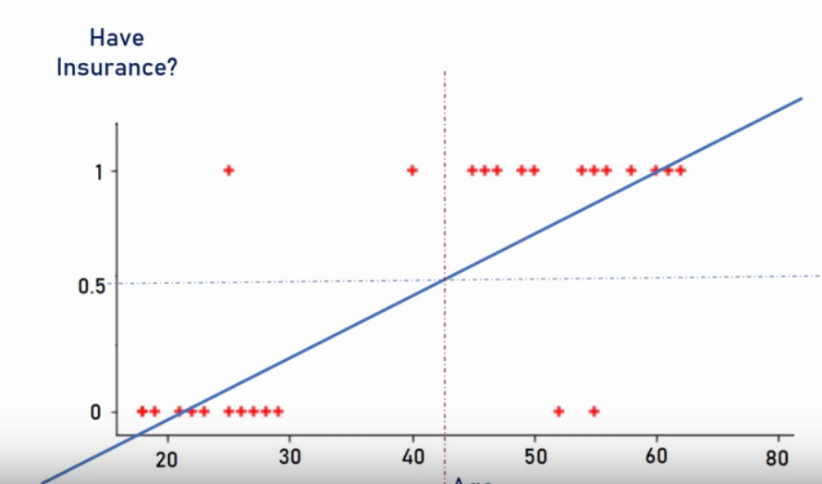
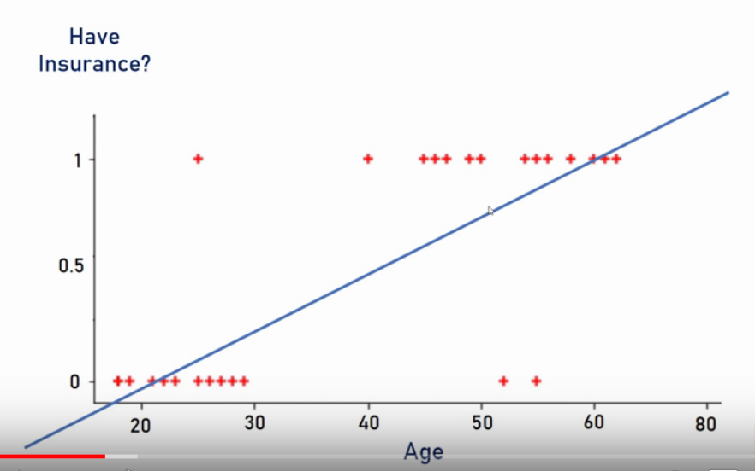
Logistic Regression – Binary Classification

Slide 19
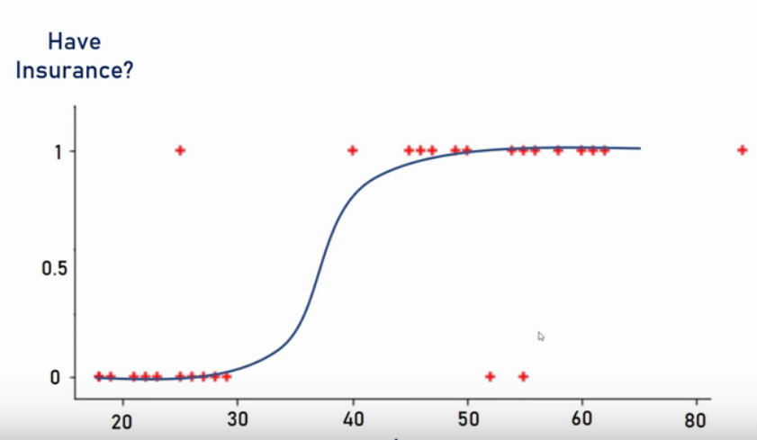
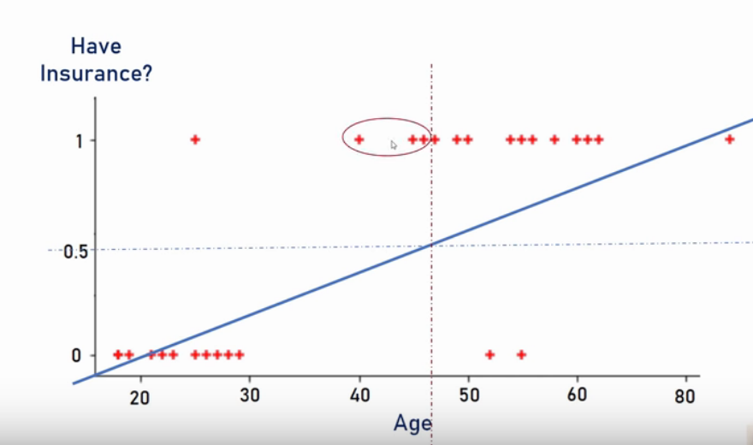
Logistic Regression – Binary Classification

Slide 20
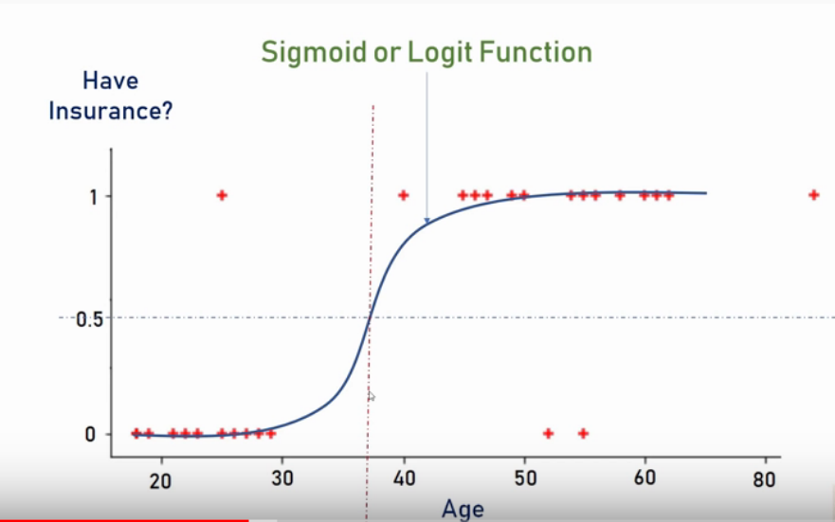
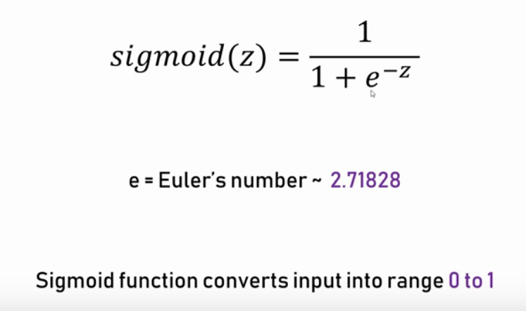
Logistic Regression – Binary Classification

Slide 21
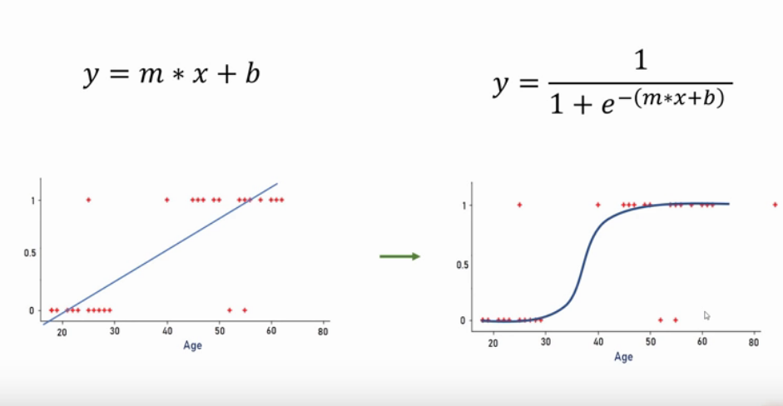
Logistic Regression – Binary Classification

Slide 22
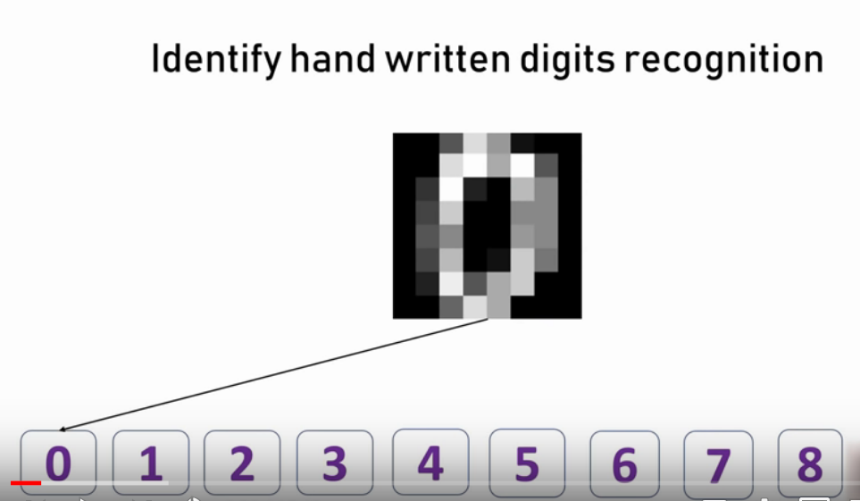
Logistic Regression – Multiclass Classification

Slide 23
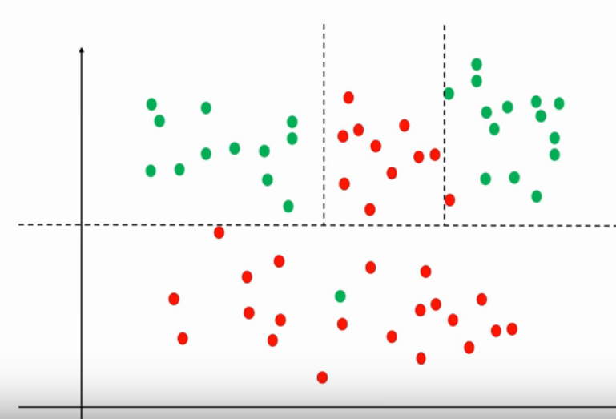
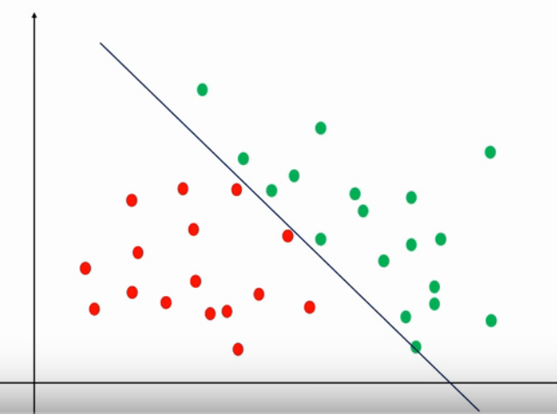
Decision Tree

Slide 24
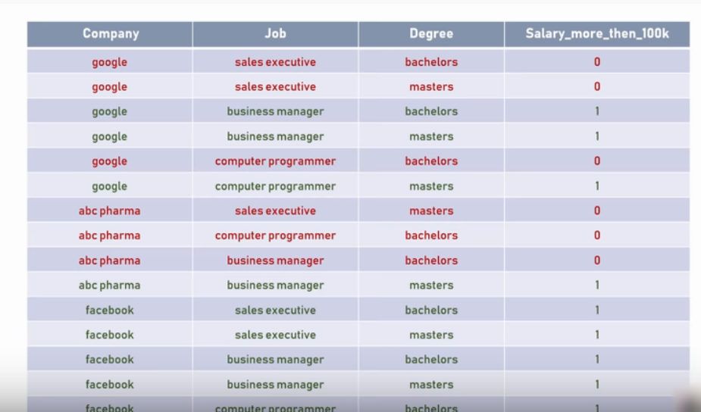
Decision Tree

Slide 25
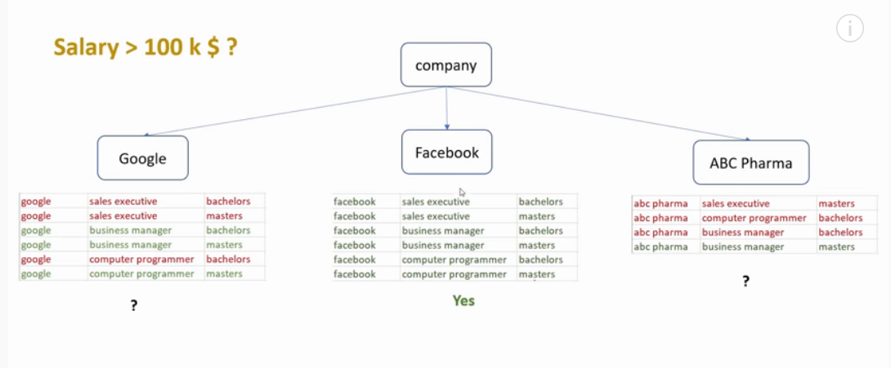
Decision Tree

Slide 26
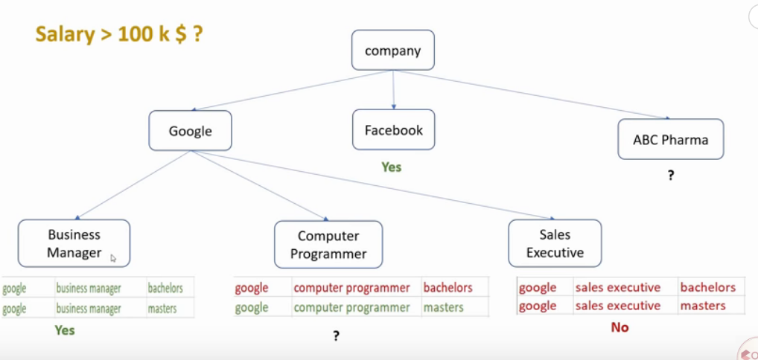
Decision Tree

Slide 27
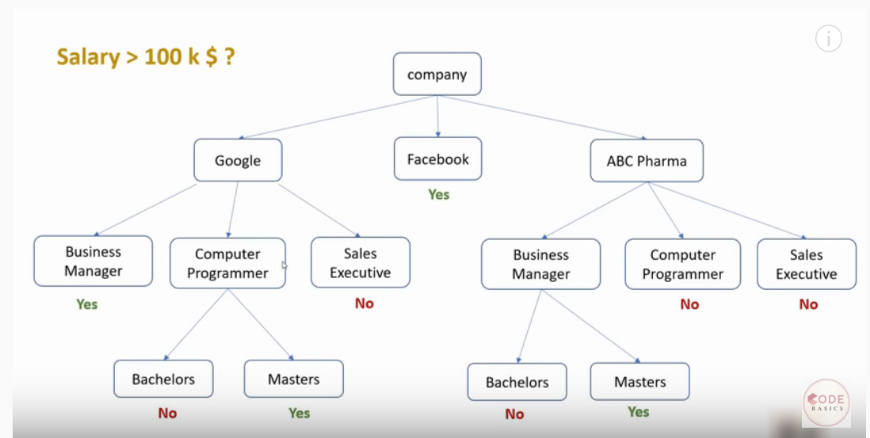
Decision Tree

Slide 28
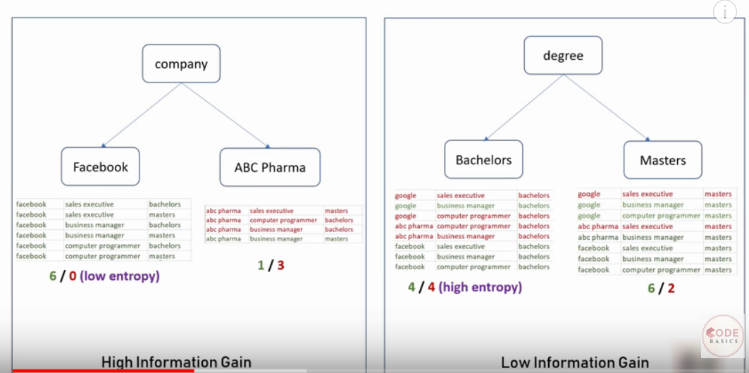
Decision Tree

Slide 29
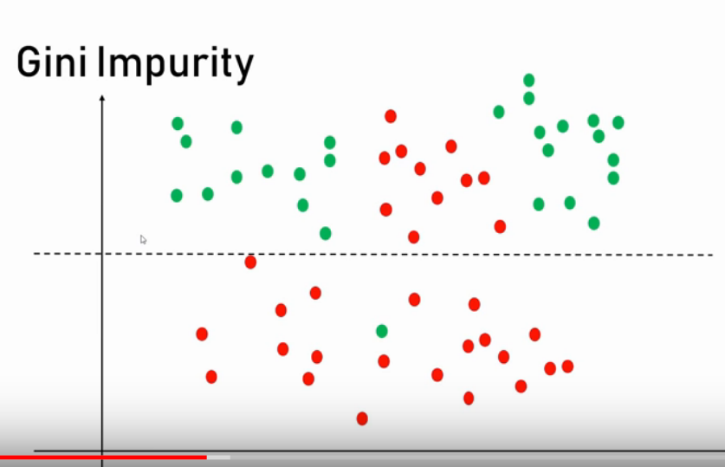
Decision Tree

Slide 30
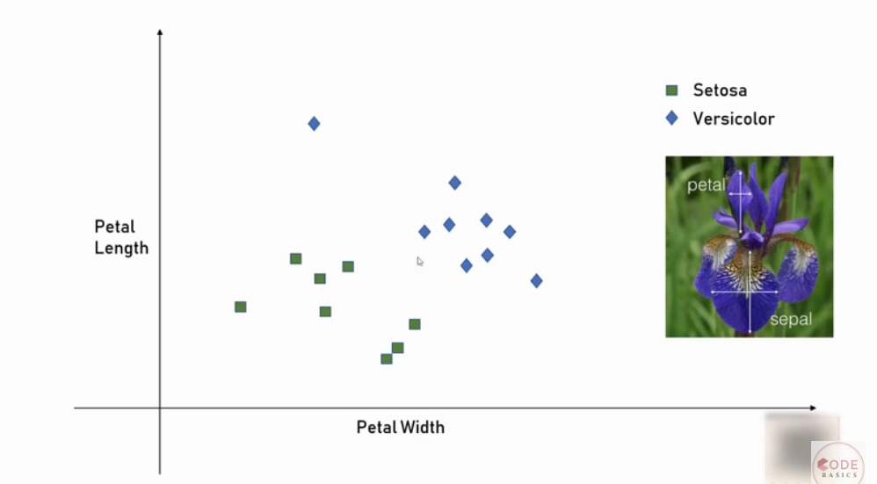
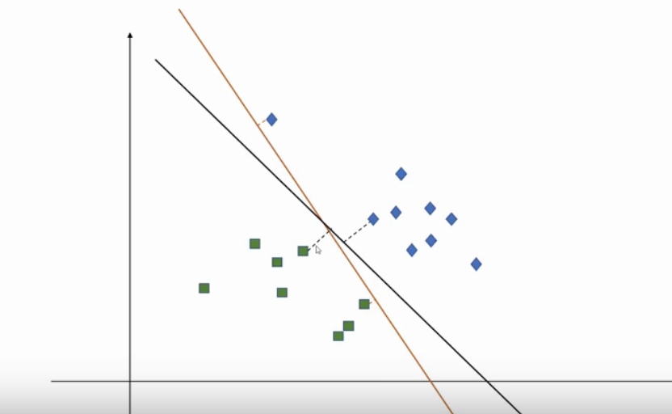
Support Vector Machine (SVM) - Classification

Slide 31
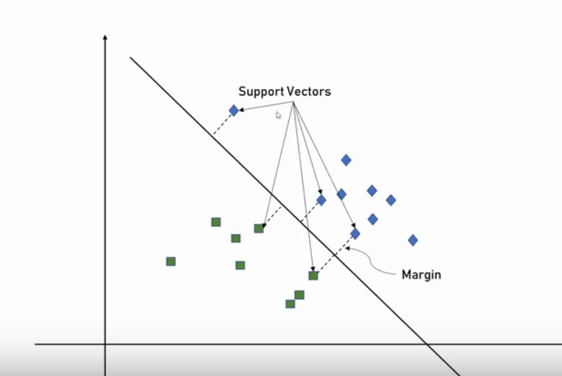
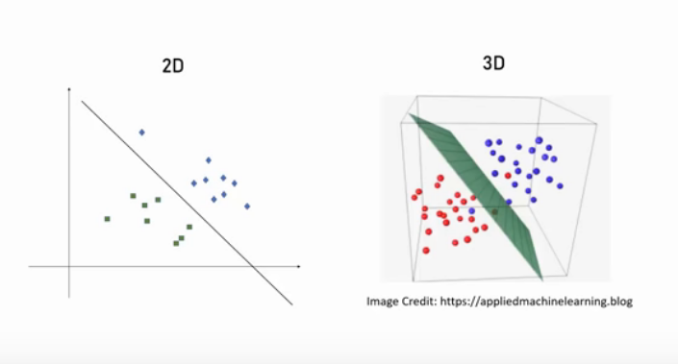
Support Vector Machine (SVM) - Classification

Slide 32
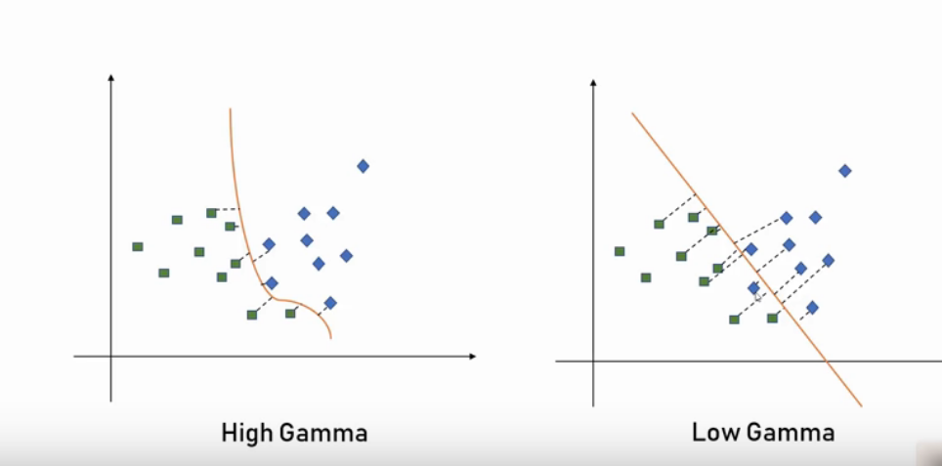
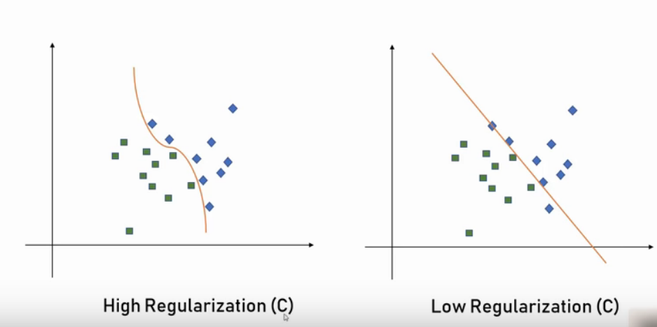
Support Vector Machine (SVM) - Classification

Slide 33
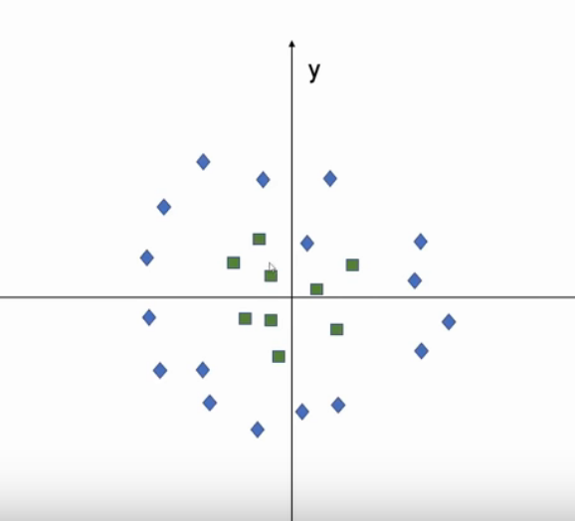
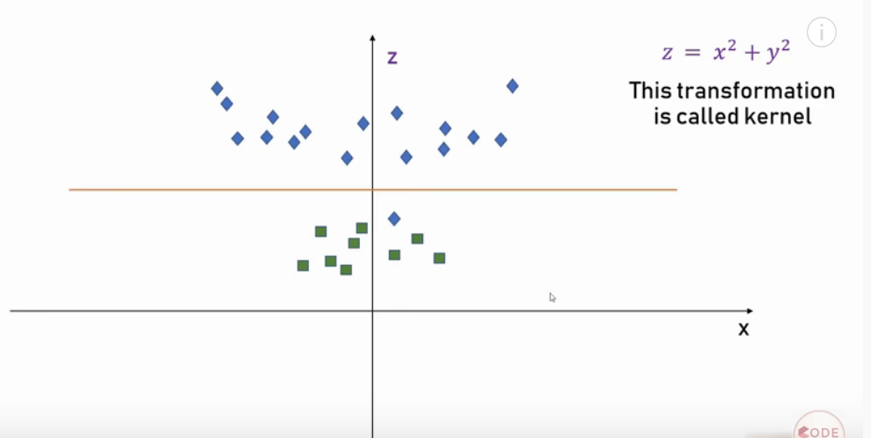
Support Vector Machine (SVM) - Classification

Slide 34
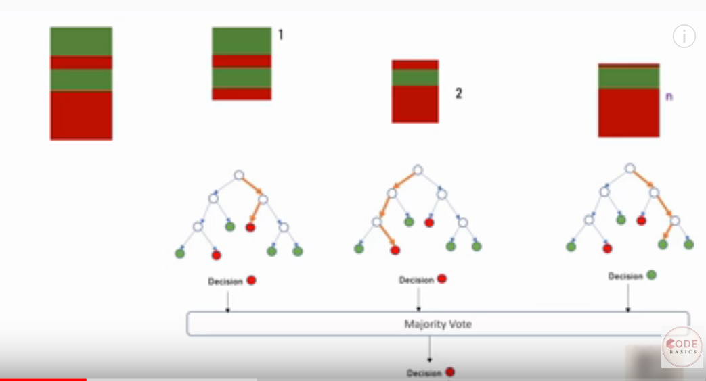
Decision Tree – Classification and Regression

Slide 35
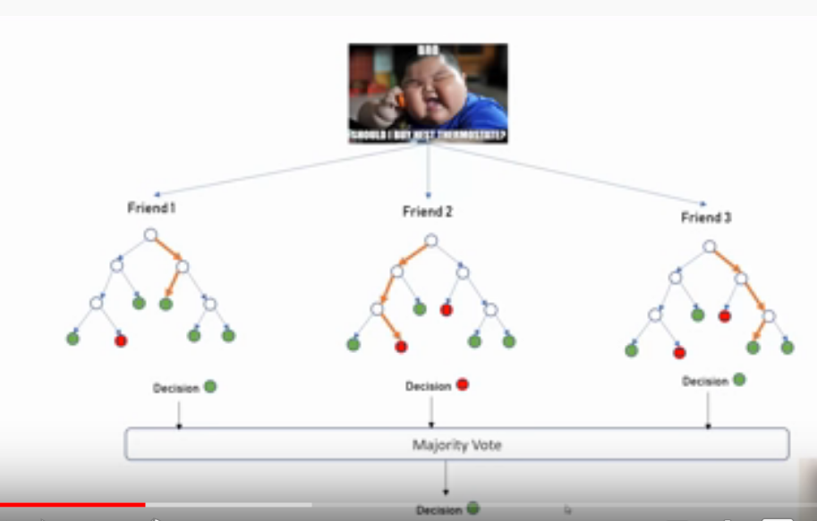
Decision Tree – Buy a thermostat or not

Slide 36
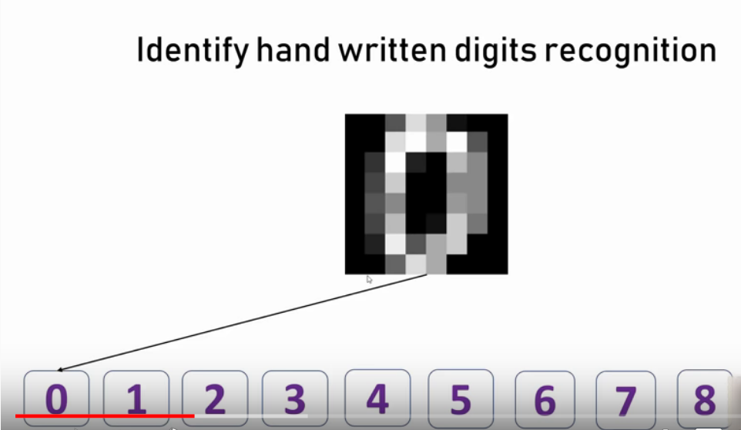
Decision Tree – Buy a thermostat or not

Slide 37
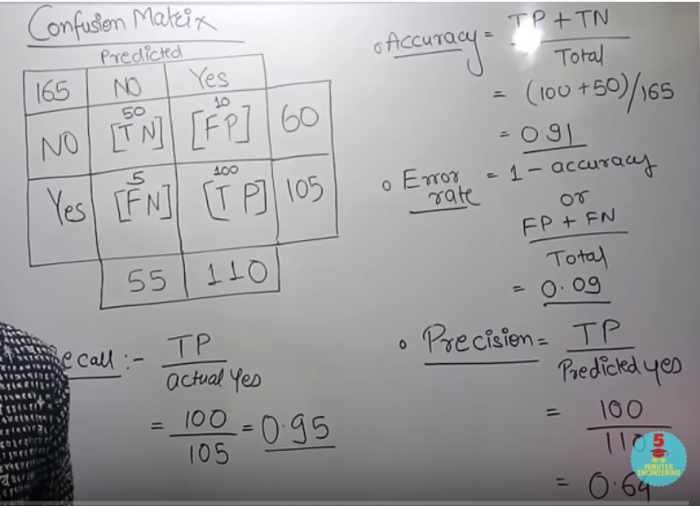
Confusion matrix

Slide 38
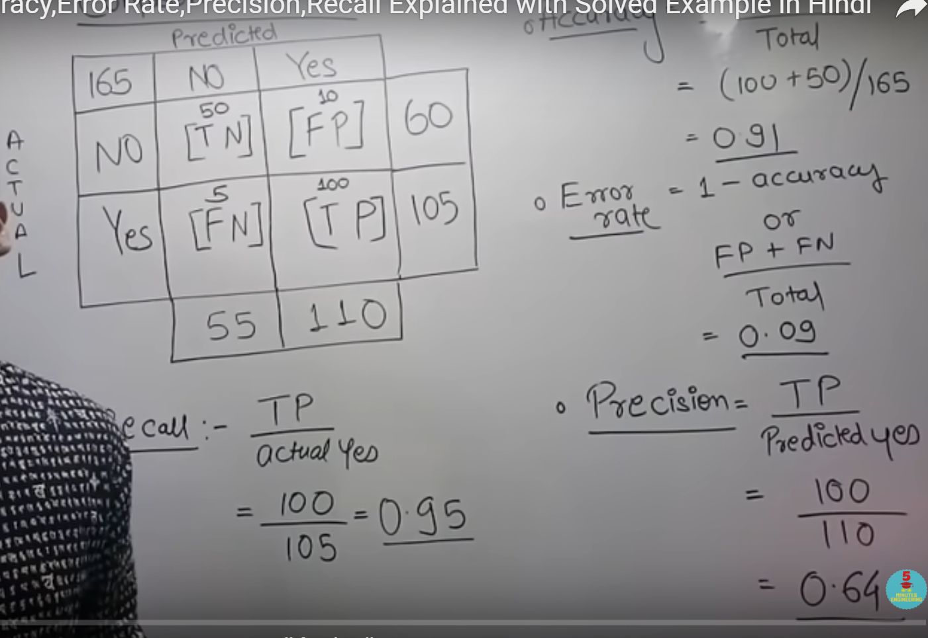
Confusion matrix

Slide 39
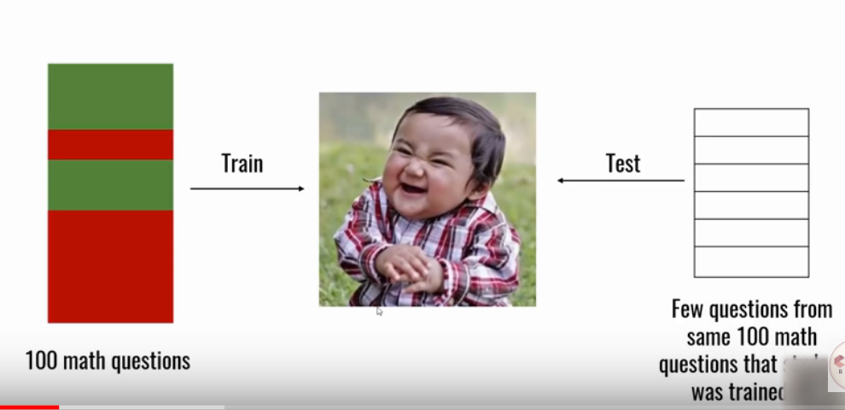
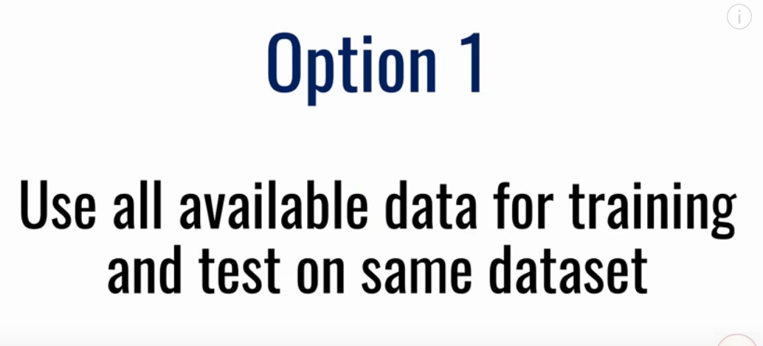
Cross Validation – Evaluating model performance

Slide 40
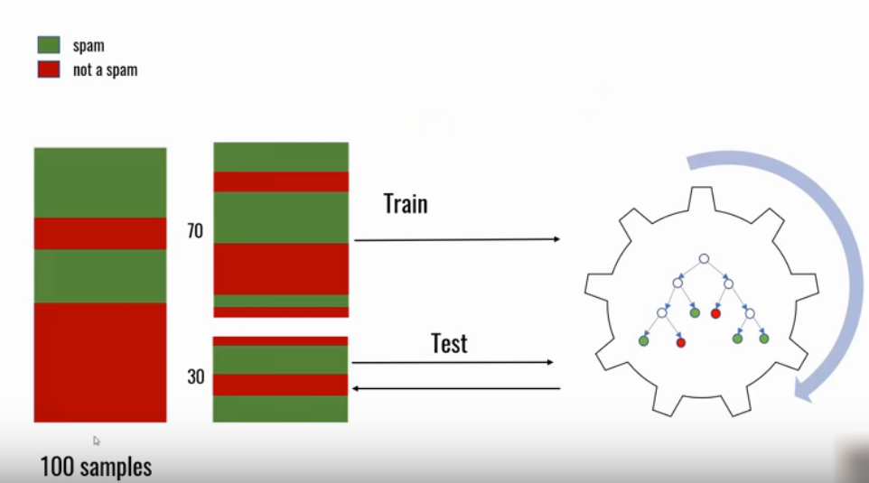
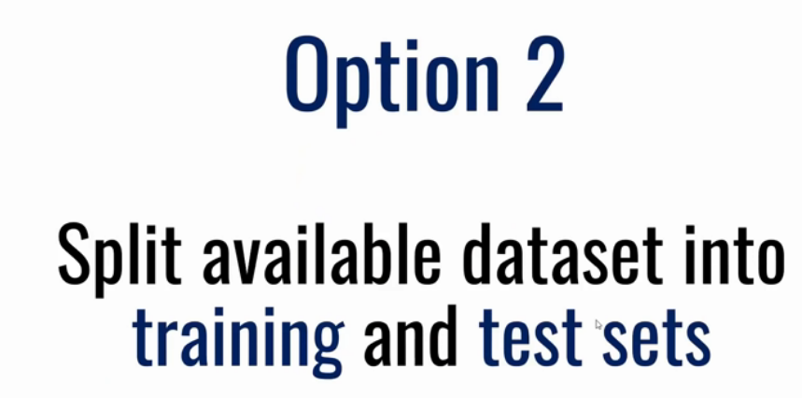
Cross Validation – Evaluating model performance

Slide 41
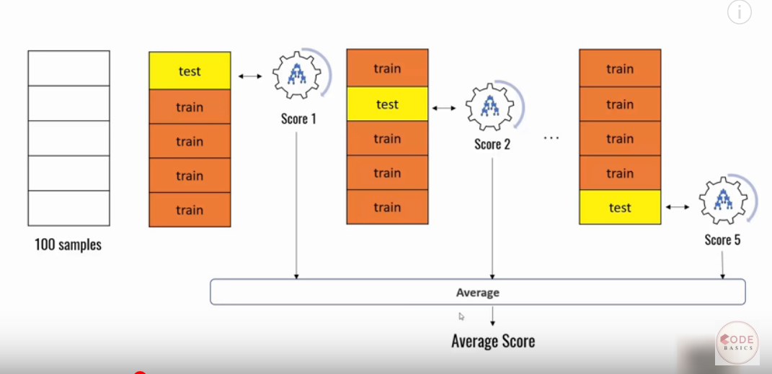
Cross Validation – Evaluating model performance – Option 3

Slide 42
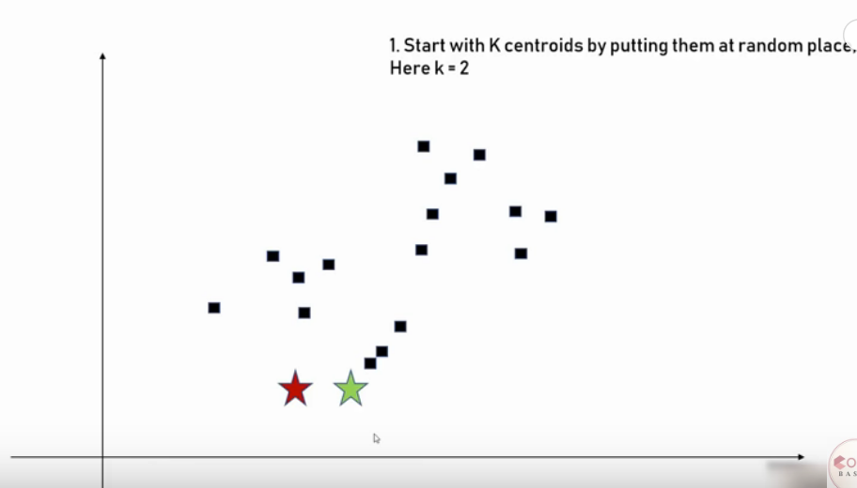
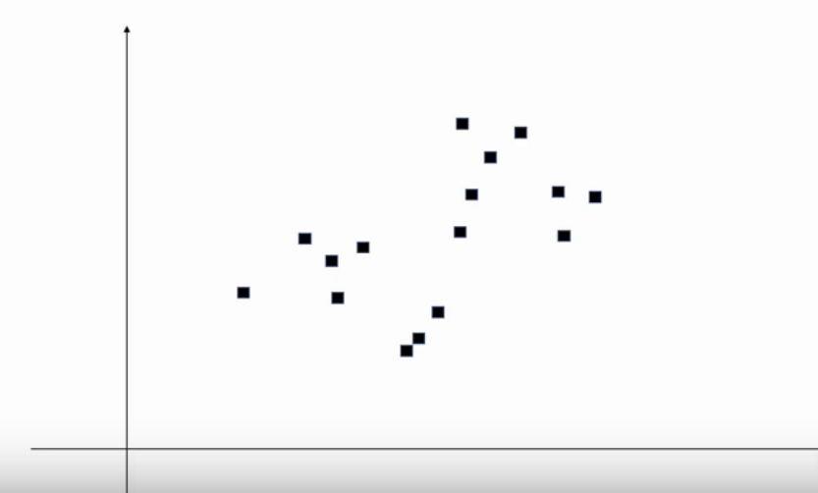
K Means Clustering – Unsupervised learning

Slide 43


K Mean Clustering – Unsupervised learning

Slide 44


K Mean Clustering – Unsupervised learning

Slide 45

K Mean Clustering – Unsupervised learning

Slide 46


Elbow method to determine K

Slide 47


K Nearest Neighbour (KNN) - Classification

Slide 48

Working of KNN

Slide 49


Working of KNN

Slide 50


Working of KNN

Slide 51
Working of KNN

Slide 52

Selection of algorithm

Slide 53
Thanks
9845547471

